Slide 1
Efficiency of an Algorithm
It refers to the “rate” at which a particular algorithm can solve the problem of size n.
It is measured by the amount of resources (time and space) it uses.
As “time” is the most important parameter for analysis, so the algorithm that can solve a problem of size n (n is very large) in less time, is regarded as an “optimal” algorithm for solving that problem of size n.

Slide 2
Efficiency of an Algorithm (cont.)
Example: An array of 10 million numbers is to be sorted. There are two computers: Computer A (faster computer) and Computer B (slower computer). Insertion Sort is to be implemented on Computer A, and Merge Sort is to be implemented on Computer B. Suppose that Computer A executes 10 billion instructions per second, and Computer B executes only 10 million instructions per second. It means that Computer A is 1000 times faster than Computer B. Assume that the world’s craftiest programmer codes Insertion Sort in machine language for Computer A, and the resulting code requires 2n² instructions to sort n numbers. Further, just an average programmer codes Merge Sort, using high-level language for Computer B, and the resulting code requires 50nlogn instructions.
By applying the formula, Time taken = No. of instructions / Speed of computer, it can be observed that Computer A takes 20,000 seconds (more than 5.5 hours), while Computer B takes 1163 seconds (less than 20 minutes).
Conclusion:- As running time of Merge Sort grows slowly as compared to Insertion Sort, even with
the slower computer (Computer B), the Computer B (implementing Merge Sort) is 17
times faster than Computer A (implementing Insertion Sort).

Slide 3
Efficiency of an Algorithm (cont.)
From the previous example, it is evident that, although Insertion Sort may perform better than Merge Sort for small inputs, but for sufficiently large input size, Merge Sort clearly outperforms Insertion Sort (in most cases; except when input is already or nearly sorted).
So, Merge Sort is considered as an efficient algorithm for sorting as compared to Insertion Sort.
An algorithm can be labelled as an “efficient” algorithm only if it exhibits drastic improvement in its performance for sufficiently large input size.

Slide 4
Asymptotic Analysis of an algorithm
Defining the mathematical bound on the running time of an algorithm, for sufficiently large input size (n).
It can be said that the Merge Sort is asymptotically efficient as compared to the Insertion Sort.
Asymptotic behaviour of an algorithm can be captured mathematically by using “Asymptotic Notations”.

Slide 5
Asymptotic Notations
Definition: Asymptotic notations are mathematical tools that allow us
to analyse an algorithm’s running time in terms of its input
size n, when n is sufficiently large (close to infinity).
This is also known as algorithm’s growth rate or rate of growth of running time of an algorithm.
Asymptotic notations can effectively capture best-case, average-case and worst-case behaviour of an algorithm.

Slide 6
Big-O notation
Represents the asymptotic upper bound on the running time of an algorithm.
Describes the worst-case behaviour of an algorithm.
Definition: For a given function g(n), we denote by O(g(n)) the set of
functions
O(g(n)) = { f(n) : there exist positive constants c and n₀ such
that 0 ≤ f(n) ≤ c g(n), for all n ≥ n₀ }

Slide 7
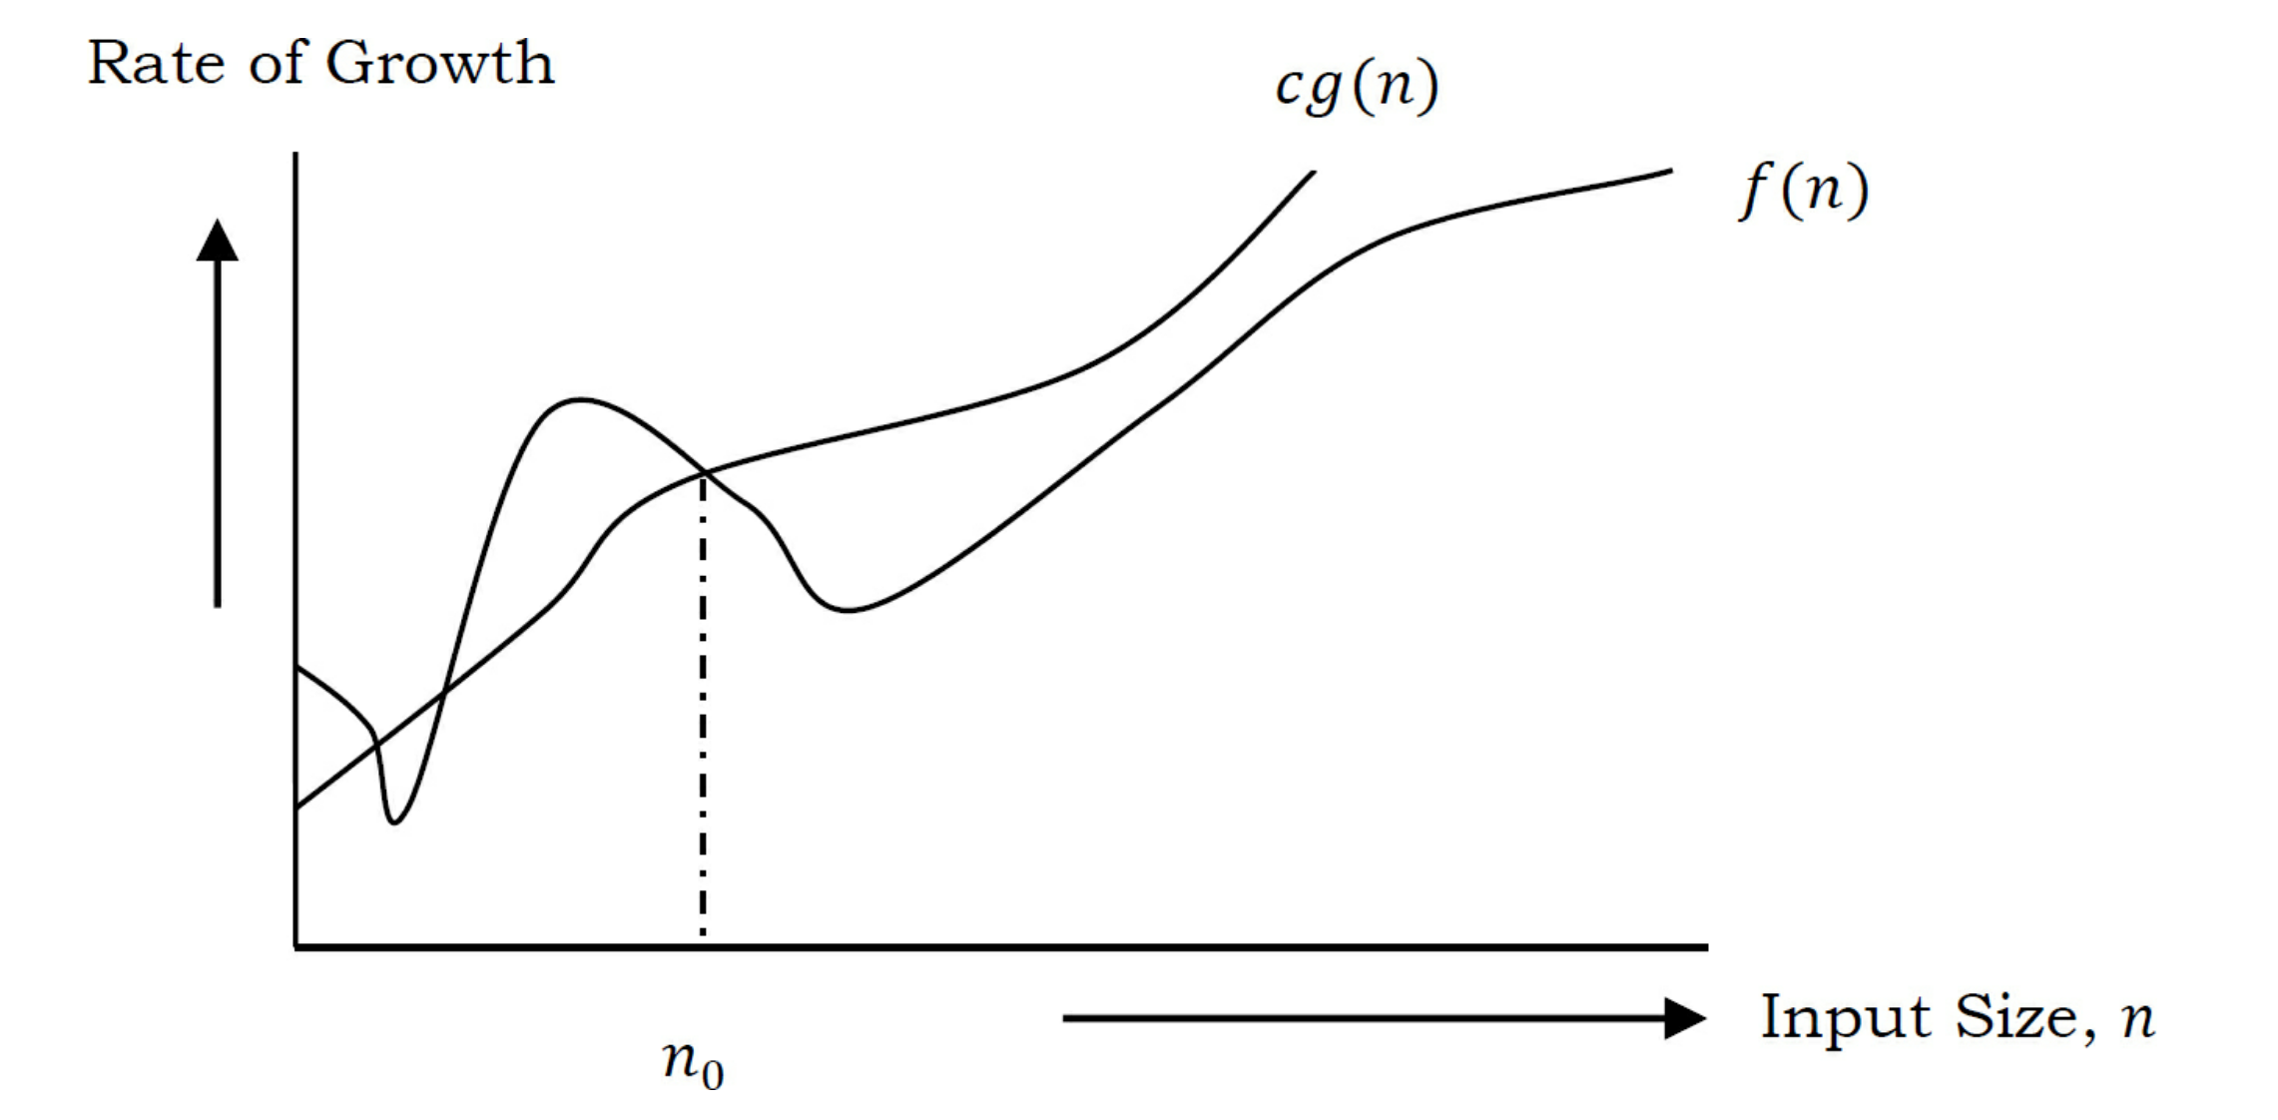

Slide 8
Big-Ω notation
Represents the asymptotic lower bound on the running time of an algorithm.
Describes the best-case behaviour of an algorithm.
Definition: For a given function g(n), we denote by Ω(g(n)) the set of
functions
Ω(g(n)) = { f(n) : there exist positive constants c and n₀ such
that 0 ≤ c g(n) ≤ f(n), for all n ≥ n₀ }

Slide 9
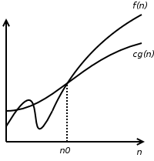

Slide 10
Θ notation
Represents the asymptotic tight bound on the running time of an algorithm.
Describes the average-case behaviour of an algorithm.
Definition: For a given function g(n), we denote by Θ(g(n)) the set of
functions
Θ(g(n)) = { f(n) : there exist positive constants c₁ , c₂ and n₀ such
that 0 ≤ c₁ g(n) ≤ f(n) ≤ c₂ g(n), for all n ≥ n₀ }

Slide 11
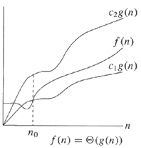

Slide 12
Little-o notation
Represents the asymptotic upper bound on the running time of an algorithm.
Describes the worst-case behaviour of an algorithm.
Definition: For a given function g(n), we denote by o(g(n)) the set of
functions
o(g(n)) = { f(n) : there exist positive constants c and n₀ such
that 0 ≤ f(n) < c g(n), for all n ≥ n₀ }

Slide 13
Little-ѡ notation
Represents the asymptotic lower bound on the running time of an algorithm.
Describes the best-case behaviour of an algorithm.
Definition: For a given function g(n), we denote by ѡ(g(n)) the set of
functions
ѡ(g(n)) = { f(n) : there exist positive constants c and n₀ such
that 0 ≤ c g(n) < f(n), for all n ≥ n₀ }

